Slide 1
Fuzzy Logic and Fuzzy Systems
Varun Deshmukh
Assistant Professor,
Department of Computer Engineering, MPSTME, Shirpur Campus

Slide 2
Introduction
Problems in real world quite often turn out to be complex owing to an element of uncertainty either in the parameters which define the problem or in the situations in which the problem occurs.
Although probability theory has been an age old and effective tool to handle uncertainty, it can be applied only to situations whose characteristics are based on random processes, that is, processes in which the occurrence of events is strictly determined by chance.
However, in reality, there turn out to be problems, a large class of them whose uncertainty is characterized by a non-random process.
Here, the uncertainty may arise due to partial information about the problem or due to information which is not fully reliable, or due to inherent imprecision in the language with which the problem is defined, or due to receipt of information from more than one source about the problem which is conflicting.

Slide 3
Introduction
It is in such situations that fuzzy set theory exhibits immense potential for effective solving of the uncertainty in the problem.
Fuzziness means vagueness. Fuzzy set theory is an excellent mathematical tool to handle the uncertainty arising due to vagueness.
Understanding human speech and recognizing handwritten characters are some common instances where fuzziness manifests.
It was Lotfi A. Zadeh who propounded the fuzzy set theory in his seminal paper (Zadeh, 1965).
Since then, a lot of theoretical developments have taken place in this field.
It is however, the Japanese who seem to have fully exploited the potential of fuzzy sets by commercializing the technology.
Thousands of patents have been acquired by the Japanese in the application of the technique and the area spans a wide spectrum, from consumer products and electronic instruments to automobile and traffic monitoring system.

Slide 4
What is Fuzzy logic?
Fuzzy logic is a mathematical language to express something.
This means it has grammar, syntax, semantic like a language for communication.
There are some other mathematical languages also known
Relational algebra (operations on sets)
Boolean algebra (operations on Boolean variables)
Predicate algebra (operations on well formed formulae (wff), also called predicate propositions)
Fuzzy logic deals with Fuzzy set or Fuzzy algebra.

Slide 5

What is fuzzy?
Dictionary meaning of fuzzy is not clear, noisy, etc.
Example: Is the picture on this slide is fuzzy?
Antonym of fuzzy is crisp
Example: Are the chips crisp?

Slide 6
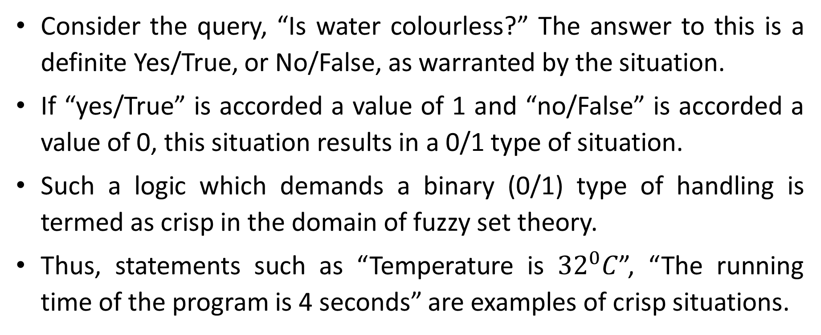
Fuzzy versus Crisp
Consider the query, “Is water colourless?” The answer to this is a definite Yes/True, or No/False, as warranted by the situation.
If “yes/True” is accorded a value of 1 and “no/False” is accorded a value of 0, this situation results in a 0/1 type of situation.
Such a logic which demands a binary (0/1) type of handling is termed as crisp in the domain of fuzzy set theory.
Thus, statements such as “Temperature is ${32}^{0}C$”, “The running time of the program is 4 seconds” are examples of crisp situations.

Slide 7
Fuzzy versus Crisp
On the other hand, consider the statement. “Is Ram honest?” The answer to this query need not be a definite “Yes” or “No”.
Considering the degree to which one knows Ram, a variety of answers spanning a range, such as “extremely honest”, “extremely dishonest”, “honest at times” or “very honest” could be generated.
If, for instance “extremely honest” were to be accorded a value of 1, at the high end of the spectrum of values, “extremely dishonest” a value of 0 at the low end of the spectrum, then, “honest at times” and “very honest” could be assigned values of 0.4 and 0.85, respectively.
This situation is therefore so fluid that it can accept values between 0 and 1, in contrast to the earlier one which was either a 0 or 1.
Such a situation is termed as fuzzy.

Slide 8
Example : Fuzzy logic vs. Crisp logic

Slide 9
Example : Fuzzy logic vs. Crisp logic

Slide 10
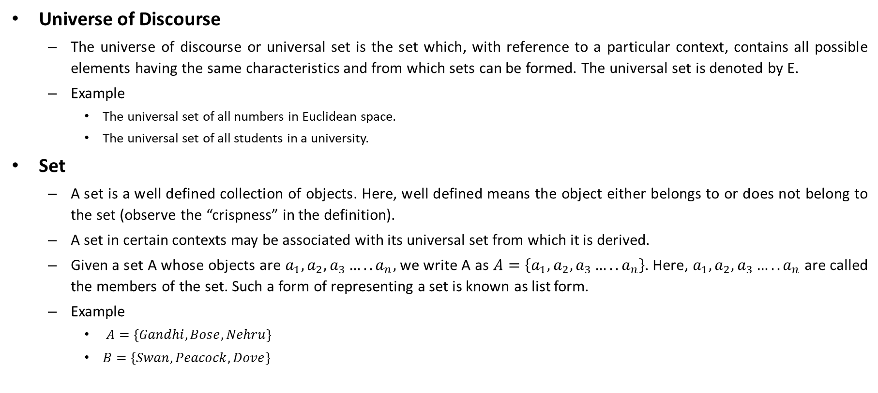
Crisp Sets
Universe of Discourse
The universe of discourse or universal set is the set which, with reference to a particular context, contains all possible elements having the same characteristics and from which sets can be formed. The universal set is denoted by E.
Example
The universal set of all numbers in Euclidean space.
The universal set of all students in a university.
Set
A set is a well defined collection of objects. Here, well defined means the object either belongs to or does not belong to the set (observe the “crispness” in the definition).
A set in certain contexts may be associated with its universal set from which it is derived.
Given a set A whose objects are $a_{1}, a_{2}, a_{3}…..a_{n},$ we write A as $A=\left\{a_{1}, a_{2}, a_{3}…..a_{n}\right\}$. Here, $a_{1}, a_{2}, a_{3}…..a_{n}$ are called the members of the set. Such a form of representing a set is known as list form.
Example
$A=\left\{Gandhi, Bose, Nehru\right\}$
$B=\{Swan, Peacock, Dove\}$

Slide 11
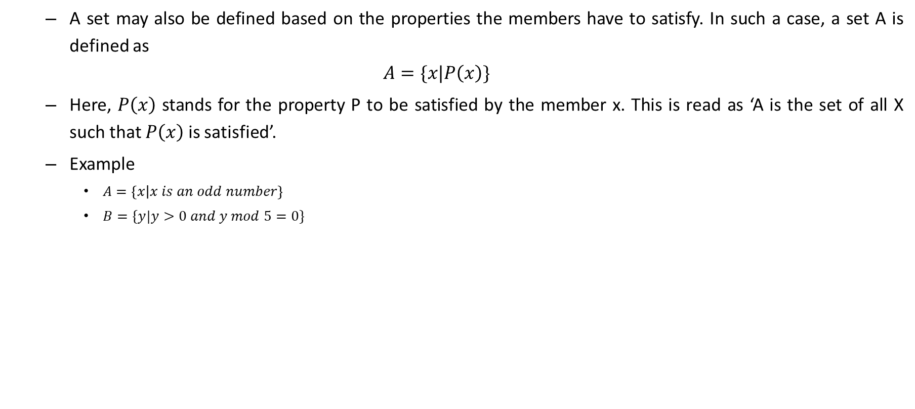
Crisp Sets
A set may also be defined based on the properties the members have to satisfy. In such a case, a set A is defined as
$$A=\{x|P\left(x\right)\}$$
Here, $P\left(x\right)$ stands for the property P to be satisfied by the member x. This is read as ‘A is the set of all X such that $P\left(x\right)$ is satisfied’.
Example
$A=\left\{x | x is an odd number\right\}$
$B=\{y|y>0 and y mod 5=0\}$

Slide 12
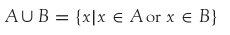
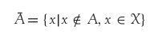
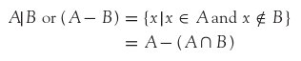
CLASSICAL SETS (CRISP SETS)
Conventional or crisp sets are Binary. An element either belongs to the set or does not.
{True, False}
{1, 0}
Operations on Crisp Set
UNION:
INTERSECTION:
Complement:
Difference:

Slide 13
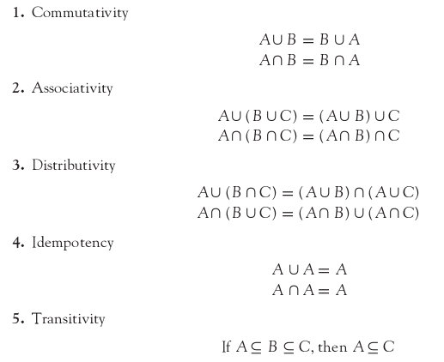
PROPERTIES OF CRISP SETS
The various properties of crisp sets are as follows:

Slide 14
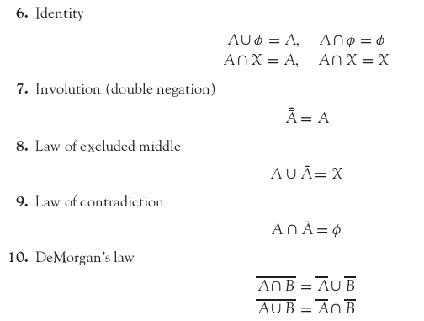
PROPERTIES OF CRISP SETS

Slide 15
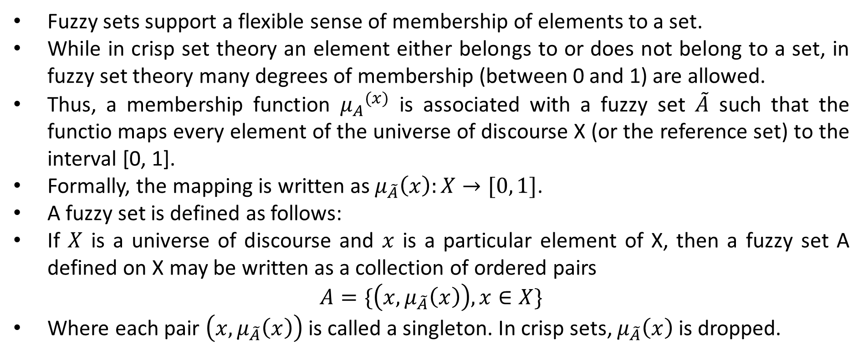
Concept of fuzzy set
Fuzzy sets support a flexible sense of membership of elements to a set.
While in crisp set theory an element either belongs to or does not belong to a set, in fuzzy set theory many degrees of membership (between 0 and 1) are allowed.
Thus, a membership function ${μ_{A}}^{(x)}$ is associated with a fuzzy set $\tilde{A}$ such that the functio maps every element of the universe of discourse X (or the reference set) to the interval [0, 1].
Formally, the mapping is written as $μ_{\tilde{A}}\left(x\right):X→[0, 1]$.
A fuzzy set is defined as follows:
If $X$ is a universe of discourse and $x$ is a particular element of X, then a fuzzy set A defined on X may be written as a collection of ordered pairs
$$A=\{\left(x,μ_{\tilde{A}}\left(x\right)\right),x∈X\}$$
Where each pair $\left(x,μ_{\tilde{A}}\left(x\right)\right)$ is called a singleton. In crisp sets, $μ_{\tilde{A}}\left(x\right)$ is dropped.

Slide 16
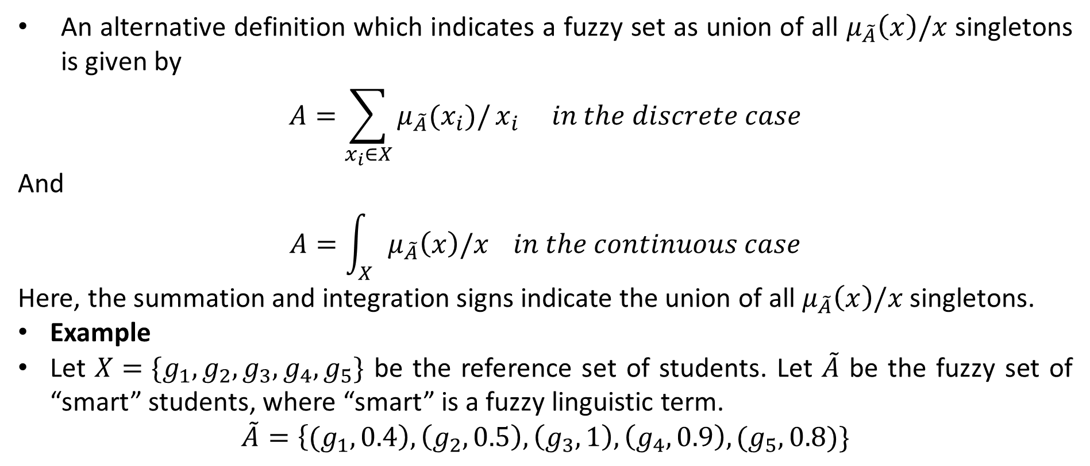
Concept of fuzzy set
An alternative definition which indicates a fuzzy set as union of all $μ_{\tilde{A}}\left(x\right)/x$ singletons is given by
$$A=\sum_{x_{i}∈X}{μ_{\tilde{A}}(x_{i})/}x_{i} in the discrete case$$
And
$$A=\int_{X}{μ_{\tilde{A}}\left(x\right)/x} in the continuous case$$
Here, the summation and integration signs indicate the union of all $μ_{\tilde{A}}\left(x\right)/x$ singletons.
Example
Let $X=\{g_{1}, g_{2}, g_{3}, g_{4}, g_{5}\}$ be the reference set of students. Let $\tilde{A}$ be the fuzzy set of “smart” students, where “smart” is a fuzzy linguistic term.
$$\tilde{A}=\left\{{(g}_{1}, 0.4\right), \left(g_{2}, 0.5\right),\left(g_{3},1\right), \left(g_{4}, 0.9\right),(g_{5},0.8)\}$$

Slide 17
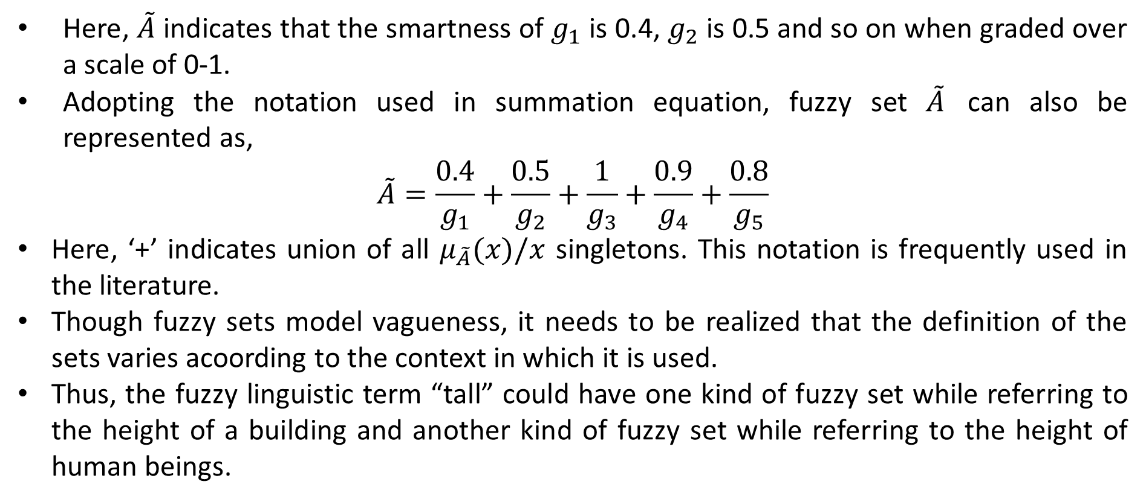
Concept of fuzzy set
Here, $\tilde{A}$ indicates that the smartness of $g_{1}$ is 0.4, $g_{2}$ is 0.5 and so on when graded over a scale of 0-1.
Adopting the notation used in summation equation, fuzzy set $\tilde{A}$ can also be represented as,
$$\tilde{A}=\frac{0.4}{g_{1}}+\frac{0.5}{g_{2}}+\frac{1}{g_{3}}+\frac{0.9}{g_{4}}+\frac{0.8}{g_{5}}$$
Here, ‘+’ indicates union of all $μ_{\tilde{A}}(x)/x$ singletons. This notation is frequently used in the literature.
Though fuzzy sets model vagueness, it needs to be realized that the definition of the sets varies acoording to the context in which it is used.
Thus, the fuzzy linguistic term “tall” could have one kind of fuzzy set while referring to the height of a building and another kind of fuzzy set while referring to the height of human beings.

Slide 19
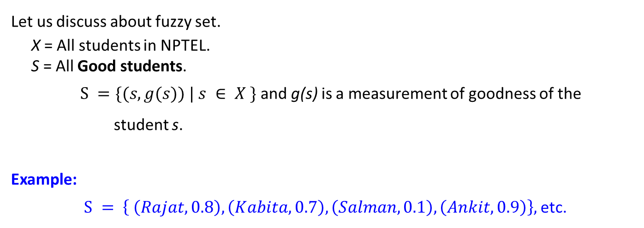
Example of fuzzy set
Let us discuss about fuzzy set.
X = All students in NPTEL.
S = All Good students.
$S =\{(s, g(s)) | s ∈ X \}$and g(s) is a measurement of goodness of the
student s.
Example:
$S = \left\{ \left(Rajat, 0.8\right), \left(Kabita, 0.7\right), \left(Salman, 0.1\right), \left(Ankit, 0.9\right)\right\},$etc.

Slide 20
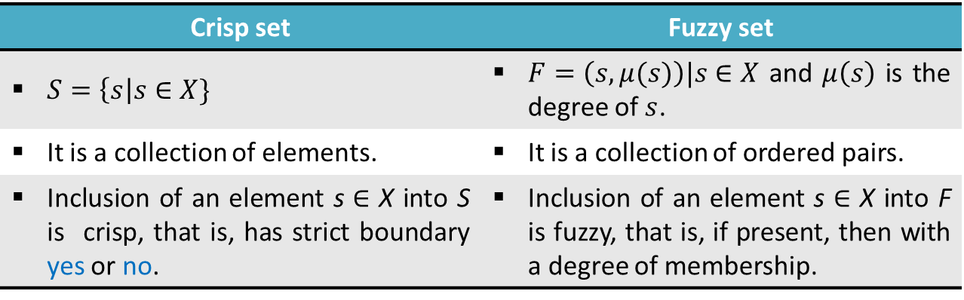
Fuzzy set vs. Crisp set
Crisp set | Fuzzy set
$S=\left\{s\right|s∈X\}$ | $F=\left(s,μ(s)\right)|s∈X$ and $μ\left(s\right)$ is the degree of$s$.
It is a collection of elements. | It is a collection of ordered pairs.
Inclusion of an element s $∈$ X into S is crisp, that is, has strict boundary yes or no. | Inclusion of an element s $∈$ X into F is fuzzy, that is, if present, then with a degree of membership.

Slide 21
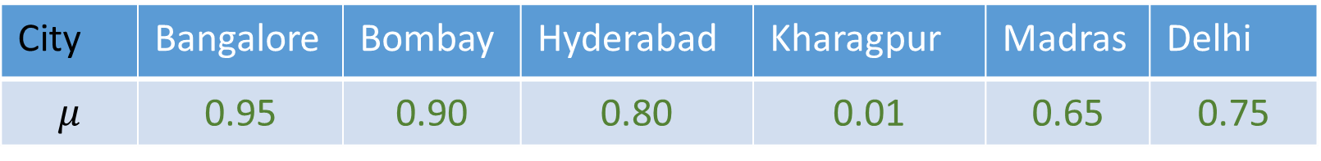
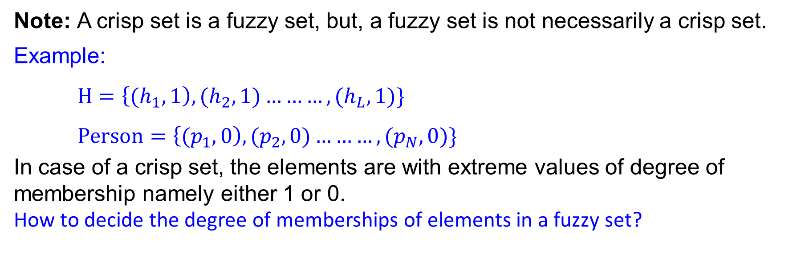
Fuzzy set vs. Crisp set
Note: A crisp set is a fuzzy set, but, a fuzzy set is not necessarily a crisp set.
Example:
$H=\left\{{(h}_{1},1\right),{(h}_{2},1)………,{(h}_{L},1)\}$
$Person=\left\{{(p}_{1},0\right),{(p}_{2},0)………,{(p}_{N},0)\}$
In case of a crisp set, the elements are with extreme values of degree of membership namely either 1 or 0.
How to decide the degree of memberships of elements in a fuzzy set?
City | Bangalore | Bombay | Hyderabad | Kharagpur | Madras | Delhi
$$μ$$ | 0.95 | 0.90 | 0.80 | 0.01 | 0.65 | 0.75
How the cities of comfort can be judged?

Slide 22
Few examples of fuzzy set
High Temperature
Low Pressure
Colour of Apple
Sweetness of Orange
Weight of Mango
Note: Degree of membership values lie in the range [0...1].

Slide 23
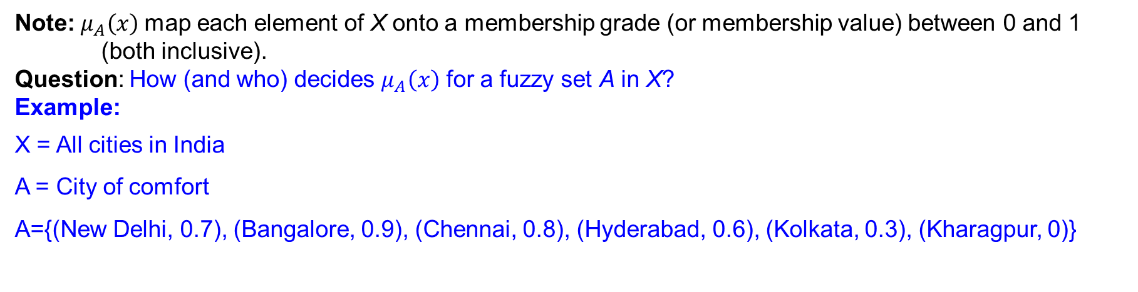
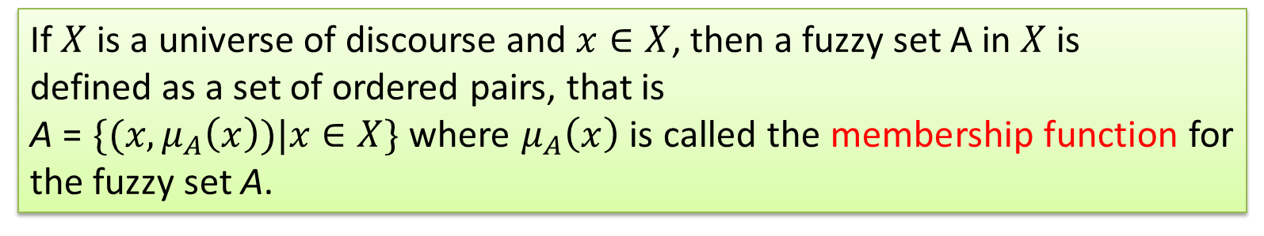
Some basic terminologies and notations
Definition 1: Membership function (and Fuzzy set)
If $X$ is a universe of discourse and $x∈X$, then a fuzzy set A in $X$ is
defined as a set of ordered pairs, that is
A = $\{(x, μ_{A}\left(x\right))|x∈X\}$ where $μ_{A}\left(x\right)$ is called the membership function for the fuzzy set A.
Note:$μ_{A}\left(x\right)$ map each element of X onto a membership grade (or membership value) between 0 and 1 (both inclusive).
Question: How (and who) decides $μ_{A}\left(x\right)$ for a fuzzy set A in X?
Example:
X = All cities in India
A = City of comfort
A={(New Delhi, 0.7), (Bangalore, 0.9), (Chennai, 0.8), (Hyderabad, 0.6), (Kolkata, 0.3), (Kharagpur, 0)}

Slide 24
Fuzzy terminologies: Support
Support: The support of a fuzzy set A is the set of all points $x∈X$ such that $μ_{A}(X)> 0$

Slide 25
Fuzzy terminologies: Core
Core: The core of a fuzzy set A is the set of all points $x$ in $X$ such that $μ_{A}\left(X\right)=$1

Slide 26
Fuzzy terminologies: Normality
Normality : A fuzzy set A is a normal if its core is non-empty. In other words, we can always find a point $x∈X$ such that $μ_{A}(X)=$1

Slide 27
Fuzzy terminologies: Crossover points
Crossover point : A crossover point of a fuzzy set A is a point $x∈X$ at which $μ_{A}(X)=$0.5. That is Crossover (A) =$\{x|μ_{A}\left(x\right)=0.5\}$

Slide 28
Fuzzy terminologies: Fuzzy Singleton
Fuzzy Singleton : A fuzzy set whose support is a single point in $X$ with $μ_{A}(x)=$1 is called a fuzzy singleton. That is $|A|=\{x|μ_{A}\left(x\right)=1\}$

Slide 29
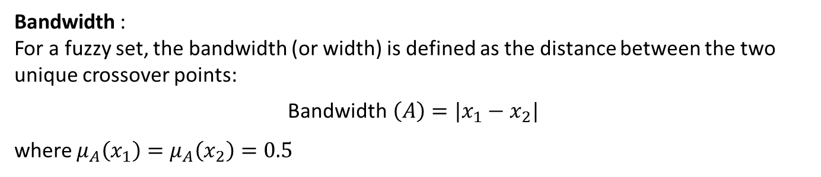
Fuzzy terminologies: Bandwidth
Bandwidth :
For a fuzzy set, the bandwidth (or width) is defined as the distance between the two unique crossover points:
Bandwidth$\left(A\right)=|x_{1}−x_{2}|$
where $μ_{A}\left(x_{1}\right)=μ_{A}\left(x_{2}\right)=0.5$

Slide 30
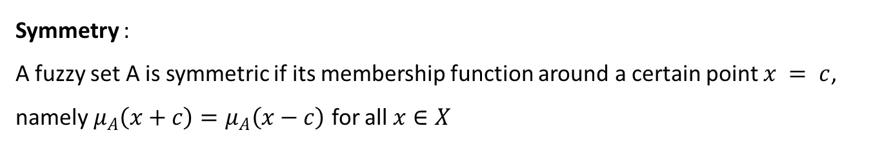
Fuzzy terminologies: Symmetry
Symmetry :
A fuzzy set A is symmetric if its membership function around a certain point $x = c$, namely $μ_{A}\left(x+c\right)=μ_{A}\left(x−c\right)$ for all $x∈X$

Slide 31
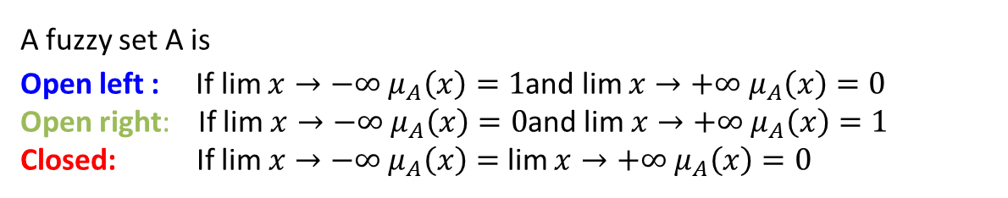
Fuzzy terminologies: Open and Closed
A fuzzy set A is
Open left : If lim $x→−∞ μ_{A}\left(x\right)=1$and lim $x→+∞ μ_{A}\left(x\right)=0$
Open right: If lim $x→−∞ μ_{A}\left(x\right)=0$and lim $x→+∞ μ_{A}\left(x\right)=1$
Closed: If lim $x→−∞ μ_{A}\left(x\right)=$ lim $x→+∞ μ_{A}\left(x\right)=0$

Slide 33
Fuzzy vs. Probability
Fuzzy : When we say about certainty of a thing
Example: A patient come to the doctor and he has to diagnose so that medicine can be prescribed.
Doctor prescribed a medicine with certainty 60% that the patient is suffering from flue. So, the disease will be cured with certainty of 60% and uncertainty 40%. Here, in stead of flue, other diseases with some other certainties may be.
Probability: When we say about the chance of an event to occur
Example: India will win the T20 tournament with a chance 60% means that out of 100 matches, India own 60 matches.

Slide 34
Prediction vs. Forecasting
The Fuzzy vs. Probability is analogical to Prediction vs. Forecasting
Prediction : When you start guessing about things.
Forecasting : When you take the information from the past job and apply it to new job.
The main difference:
Prediction is based on the best guess from experiences.
Forecasting is based on data you have actually recorded and packed from previous job.

Slide 35
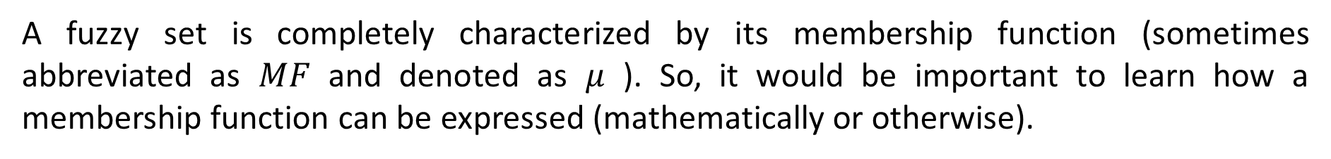
Fuzzy membership functions
A fuzzy set is completely characterized by its membership function (sometimes abbreviated as $MF$ and denoted as $μ$ ). So, it would be important to learn how a membership function can be expressed (mathematically or otherwise).
Example:
Note: A membership function can be on
a discrete universe of discourse and
a continuous universe of discourse.

Slide 36
Fuzzy membership functions
So, membership function on a discrete universe of course is trivial. However, a membership function on a continuous universe of discourse needs a special attention.
Following figures shows typical examples of membership functions.

Slide 37
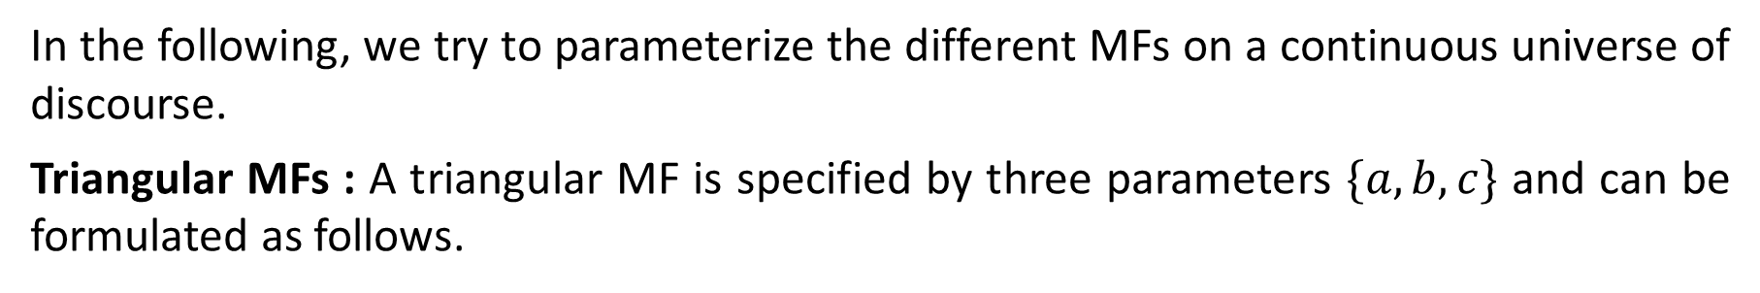
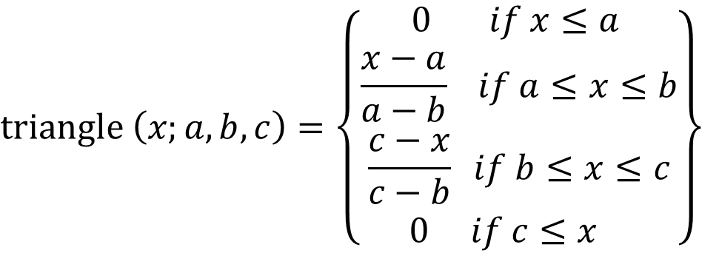
Fuzzy MFs : Formulation and parameterization
In the following, we try to parameterize the different MFs on a continuous universe of discourse.
Triangular MFs : A triangular MF is specified by three parameters $\{a, b, c\}$ and can be formulated as follows.
$$triangle \left(x;a,b,c\right)=\left\{\begin{matrix}0 if x≤a \\ \frac{x−a}{a−b} if a≤x≤b \\ \frac{c−x}{c−b} if b≤x≤c \\ 0 if c≤x \end{matrix}\right\}$$

Slide 38
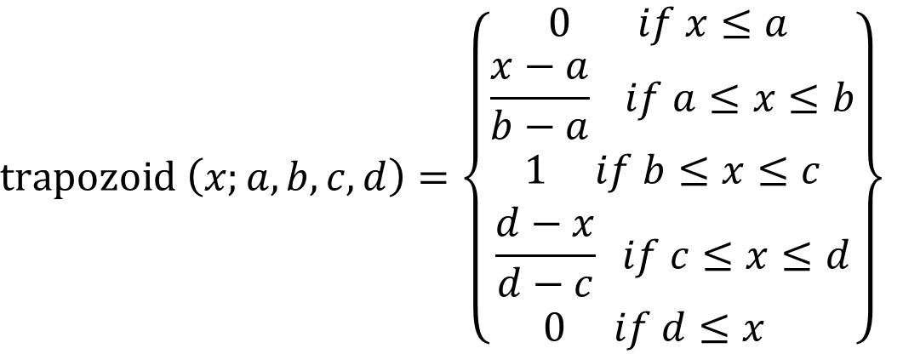
Fuzzy MFs: Trapezoidal
A trapezoidal MF is specified by four parameters {$a, b, c, d\}$and can be defined as follows:
$$trapozoid \left(x;a,b,c, d\right)=\left\{\begin{matrix}0 if x≤a \\ \frac{x−a}{b−a} if a≤x≤b \\ 1 if b≤x≤c \\ \frac{d−x}{d−c} if c≤x≤d \\ 0 if d≤x \end{matrix}\right\}$$

Slide 39
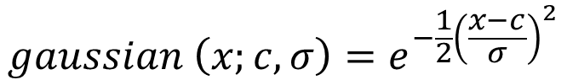
Fuzzy MFs: Gaussian
A Gaussian MF is specified by two parameters $\left\{c,σ\right\}$ and can be defined as below:
$$gaussian \left(x;c,σ\right)=e^{−\frac{1}{2}{\left(\frac{x−c}{σ}\right)}^{2}}$$

Slide 40
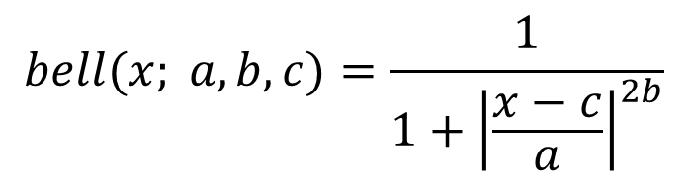
Fuzzy MFs: Generalized bell
It is also called Cauchy MF. A generalized bell MF is specified by three parameters $\{a, b, c$} and is defined as:
$$bell(x; a, b, c)=\frac{1}{1+{\left|\frac{x−c}{a}\right|}^{2b}}$$

Slide 41
Example: Generalized bell MFs
Example: $μ\left(x\right)=\frac{1}{1+{\left|x\right|}^{2}}$;
a = b = 1 and c = 0;

Slide 42
Fuzzy MFs: Sigmoidal MFs
Parameters: $\{a, c\}$; where $c$ = crossover point and $a$ = slope at $c$;
$$Sigmoid(x; a, c)=\frac{1}{1+e^{−\left[\frac{x−c}{a}\right]}}$$

Slide 43
Basic fuzzy set operations: Union
Union (A $∪$ B):
$$μ_{A∪B}\left(x\right)=max⁡(μ_{A}\left(x\right),μ_{B}\left(x\right))$$
Example:
$A =\{(x1, 0.5), (x2, 0.1), (x3, 0.4)\} and$
$B =\{\left(x1, 0.2\right), \left(x2, 0.3\right), \left(x3, 0.5\right)\};$
$C = A ∪ B =\{\left(x1, 0.5\right), \left(x2, 0.3\right), \left(x3, 0.5\right)\}$

Slide 44
Basic fuzzy set operations: Intersection
Intersection (A $∩$ B):
$$μ_{A∩B}\left(x\right)=min⁡(μ_{A}\left(x\right),μ_{B}\left(x\right))$$
Example:
$A =\{(x1, 0.5), (x2, 0.1), (x3, 0.4)\} and$
$B =\{\left(x1, 0.2\right), \left(x2, 0.3\right), \left(x3, 0.5\right)\};$
$C = A ∩ B =\{\left(x1, 0.2\right), \left(x2, 0.1\right), \left(x3, 0.4\right)\}$

Slide 45
Basic fuzzy set operations: Complement
Complement ($A^{c}$):
$$μ_{A^{c}}\left(x\right)=1−μ_{A}\left(x\right)$$
Example:
$A =\{(x1, 0.5), (x2, 0.1), (x3, 0.4)\}$
$C =A^{c}=\{\left(x1, 0.5\right), \left(x2, 0.9\right), \left(x3, 0.6\right)\}$

Slide 46
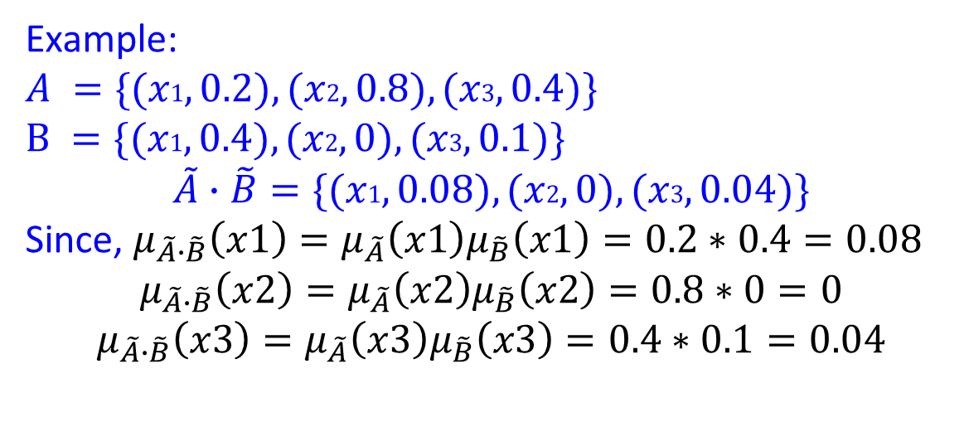
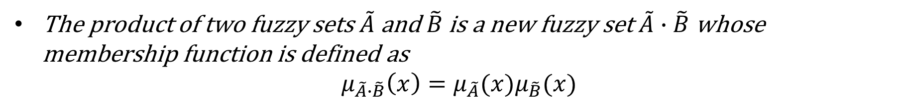
Basic fuzzy set operations: product of two fuzzy sets
The product of two fuzzy sets $\tilde{A}$ and $\tilde{B}$ is a new fuzzy set $\tilde{A}∙\tilde{B}$ whose membership function is defined as
$$μ_{\tilde{A}∙\tilde{B}}\left(x\right)=μ_{\tilde{A}}(x)μ_{\tilde{B}}(x)$$
Example:
$A =\{(x1, 0.2), (x2, 0.8), (x3, 0.4)\}$
$B =\{(x1, 0.4), (x2, 0), (x3, 0.1)\}$
$$\tilde{A}∙\tilde{B}=\{(x1, 0.08), (x2, 0), (x3, 0.04)\}$$
Since, $μ_{\tilde{A}∙\tilde{B}}\left(x1\right)=μ_{\tilde{A}}\left(x1\right)μ_{\tilde{B}}\left(x1\right)=0.2∗0.4=0.08$
$$μ_{\tilde{A}∙\tilde{B}}\left(x2\right)=μ_{\tilde{A}}\left(x2\right)μ_{\tilde{B}}\left(x2\right)=0.8∗0=0$$
$$μ_{\tilde{A}∙\tilde{B}}\left(x3\right)=μ_{\tilde{A}}\left(x3\right)μ_{\tilde{B}}\left(x3\right)=0.4∗0.1=0.04$$

Slide 47
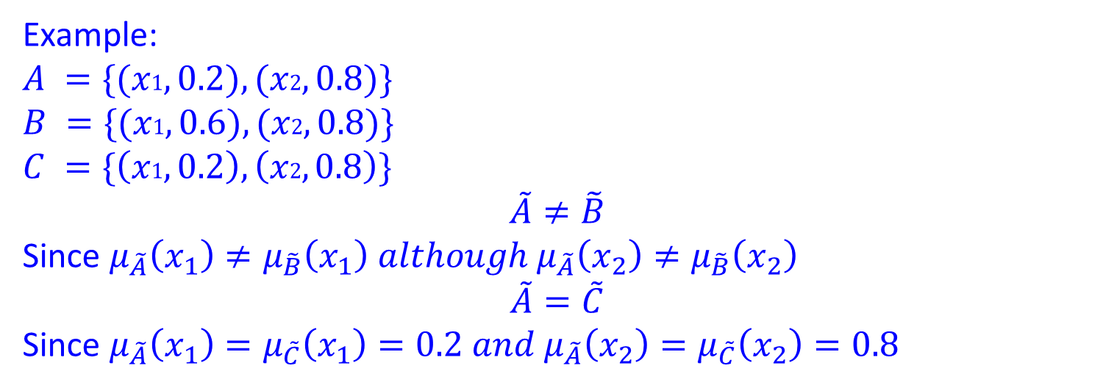
Basic fuzzy set operations: Equality
Two fuzzy sets $\tilde{A}$ and $\tilde{B}$ are said to be equal ($\tilde{A}=\tilde{B})$ if $μ_{\tilde{A}}\left(x\right)=μ_{\tilde{B}}(x)$
Example:
$A =\{(x1, 0.2), (x2, 0.8)\}$
$B =\{(x1, 0.6), (x2, 0.8)\}$
$$C =\{\left(x1, 0.2\right), \left(x2, 0.8\right)\}$$
$$\tilde{A}≠\tilde{B}$$
Since $μ_{\tilde{A}}\left(x_{1}\right)≠μ_{\tilde{B}}\left(x_{1}\right) although{ μ}_{\tilde{A}}\left(x_{2}\right)≠μ_{\tilde{B}}\left(x_{2}\right)$
$$\tilde{A}=\tilde{C}$$
Since $μ_{\tilde{A}}\left(x_{1}\right)=μ_{\tilde{C}}\left(x_{1}\right)=0.2 and μ_{\tilde{A}}\left(x_{2}\right)=μ_{\tilde{C}}\left(x_{2}\right)=0.8$

Slide 48
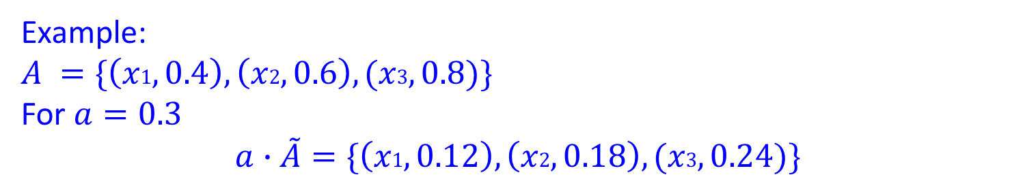
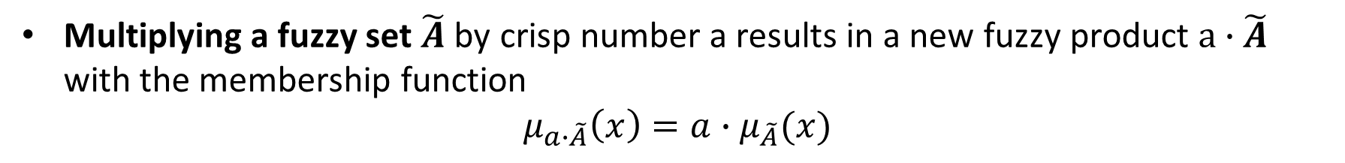
Basic fuzzy set operations: product of fuzzy set with crisp number
Multiplying a fuzzy set $\tilde{A}$ by crisp number a results in a new fuzzy product $a∙\tilde{A}$ with the membership function
$$μ_{a∙\tilde{A}}\left(x\right)=a∙μ_{\tilde{A}}(x)$$
Example:
$A =\{\left(x1, 0.4\right), \left(x2, 0.6\right),(x3, 0.8)\}$
For $a=0.3$
$$a∙\tilde{A}=\{\left(x1, 0.12\right), \left(x2, 0.18\right),(x3, 0.24)\}$$

Slide 49
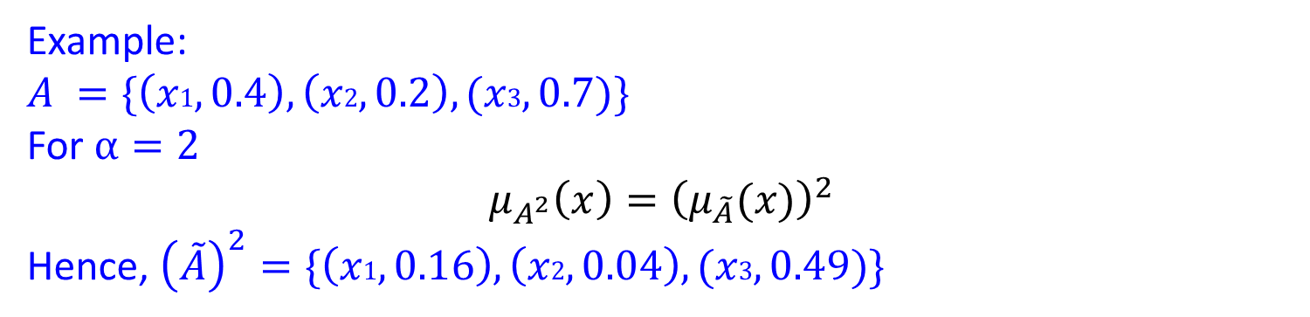
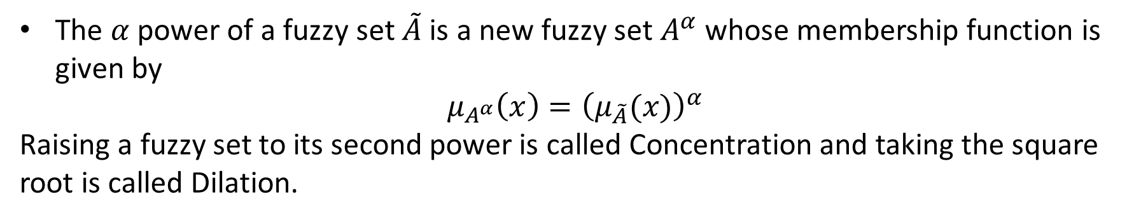
Basic fuzzy set operations: Power of a fuzzy set
The $α$ power of a fuzzy set $\tilde{A}$ is a new fuzzy set $A^{α}$ whose membership function is given by
$$μ_{A^{α}}\left(x\right)={\left(μ_{\tilde{A}}(x)\right)}^{α}$$
Raising a fuzzy set to its second power is called Concentration and taking the square root is called Dilation.
Example:
$A =\{\left(x1, 0.4\right), \left(x2, 0.2\right),(x3, 0.7)\}$
For $α=2$
$$μ_{A^{2}}\left(x\right)={\left(μ_{\tilde{A}}(x)\right)}^{2}$$
Hence, ${\left(\tilde{A}\right)}^{2}=\{\left(x1, 0.16\right), \left(x2, 0.04\right),(x3, 0.49)\}$

Slide 50
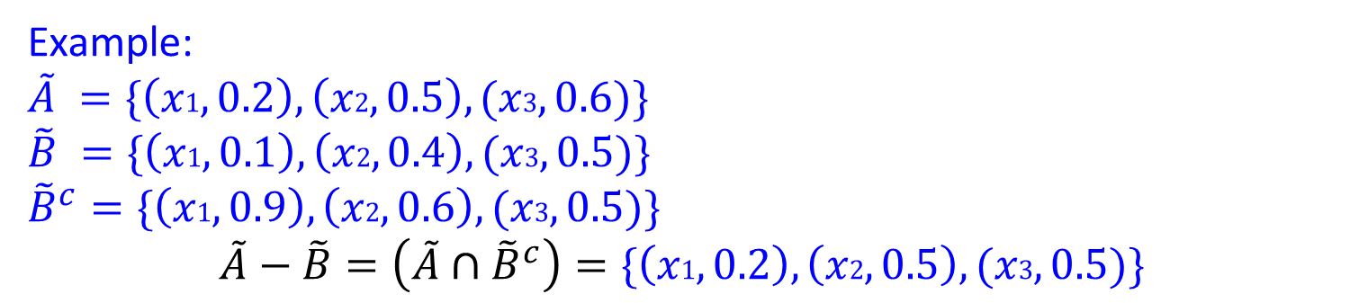
Basic fuzzy set operations: Difference
The difference of two fuzzy sets $\tilde{A}$ and $\tilde{B}$ is a new fuzzy set $\tilde{A}−\tilde{B}$ defined as
$$\tilde{A}−\tilde{B}=\left(\tilde{A}{∩\tilde{B}}^{c}\right)$$
Example:
$\tilde{A} =\{\left(x1, 0.2\right), \left(x2, 0.5\right),(x3, 0.6)\}$
$\tilde{B} =\{\left(x1, 0.1\right), \left(x2, 0.4\right),(x3, 0.5)\}$
${\tilde{B}}^{c}=\{\left(x1, 0.9\right), \left(x2, 0.6\right),(x3, 0.5)\}$
$$\tilde{A}−\tilde{B}=\left(\tilde{A}∩{\tilde{B}}^{c}\right)=\{\left(x1, 0.2\right), \left(x2, 0.5\right),(x3, 0.5)\}$$

Slide 51
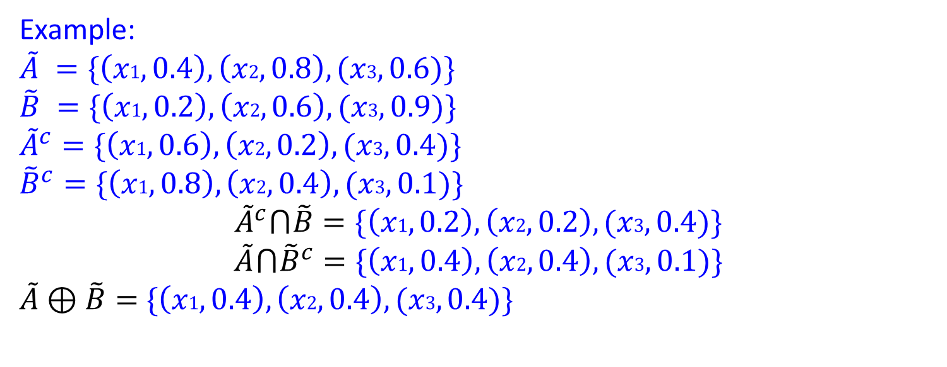
Basic fuzzy set operations: Disjunctive Sum
The disjunctive sum of two fuzzy sets $\tilde{A}$and $\tilde{B}$is a new fuzzy set $\tilde{A}⨁\tilde{B}$ defined as
$$\tilde{A}⊕\tilde{B}=\left({\tilde{A}}^{c}⋂\tilde{B}\right)⋃\left(\tilde{A}⋂{\tilde{B}}^{c}\right)$$
Example:
$\tilde{A} =\{\left(x1, 0.4\right), \left(x2, 0.8\right),(x3, 0.6)\}$
$\tilde{B} =\{\left(x1, 0.2\right), \left(x2, 0.6\right),(x3, 0.9)\}$
${\tilde{A}}^{c}=\{\left(x1, 0.6\right), \left(x2, 0.2\right),(x3, 0.4)\}$
${\tilde{B}}^{c}=\{\left(x1, 0.8\right), \left(x2, 0.4\right),(x3, 0.1)\}$
$${\tilde{A}}^{c}⋂\tilde{B}=\{\left(x1, 0.2\right), \left(x2, 0.2\right),(x3, 0.4)\}$$
$$\tilde{A}⋂{\tilde{B}}^{c}=\{\left(x1, 0.4\right), \left(x2, 0.4\right),(x3, 0.1)\}$$
$\tilde{A}⊕\tilde{B}=$ $\{\left(x1, 0.4\right), \left(x2, 0.4\right),(x3, 0.4)\}$

Slide 52
Basic fuzzy set operations: Products
Algebric product or Vector product ($A∙B$):
$$μ_{A∙B}\left(x\right)=μ_{A}\left(x\right)∙μ_{B}\left(x\right)$$
Scalar product ($α×A$):
$$μ_{αA}\left(x\right)={α×μ}_{A}\left(x\right)$$

Slide 53
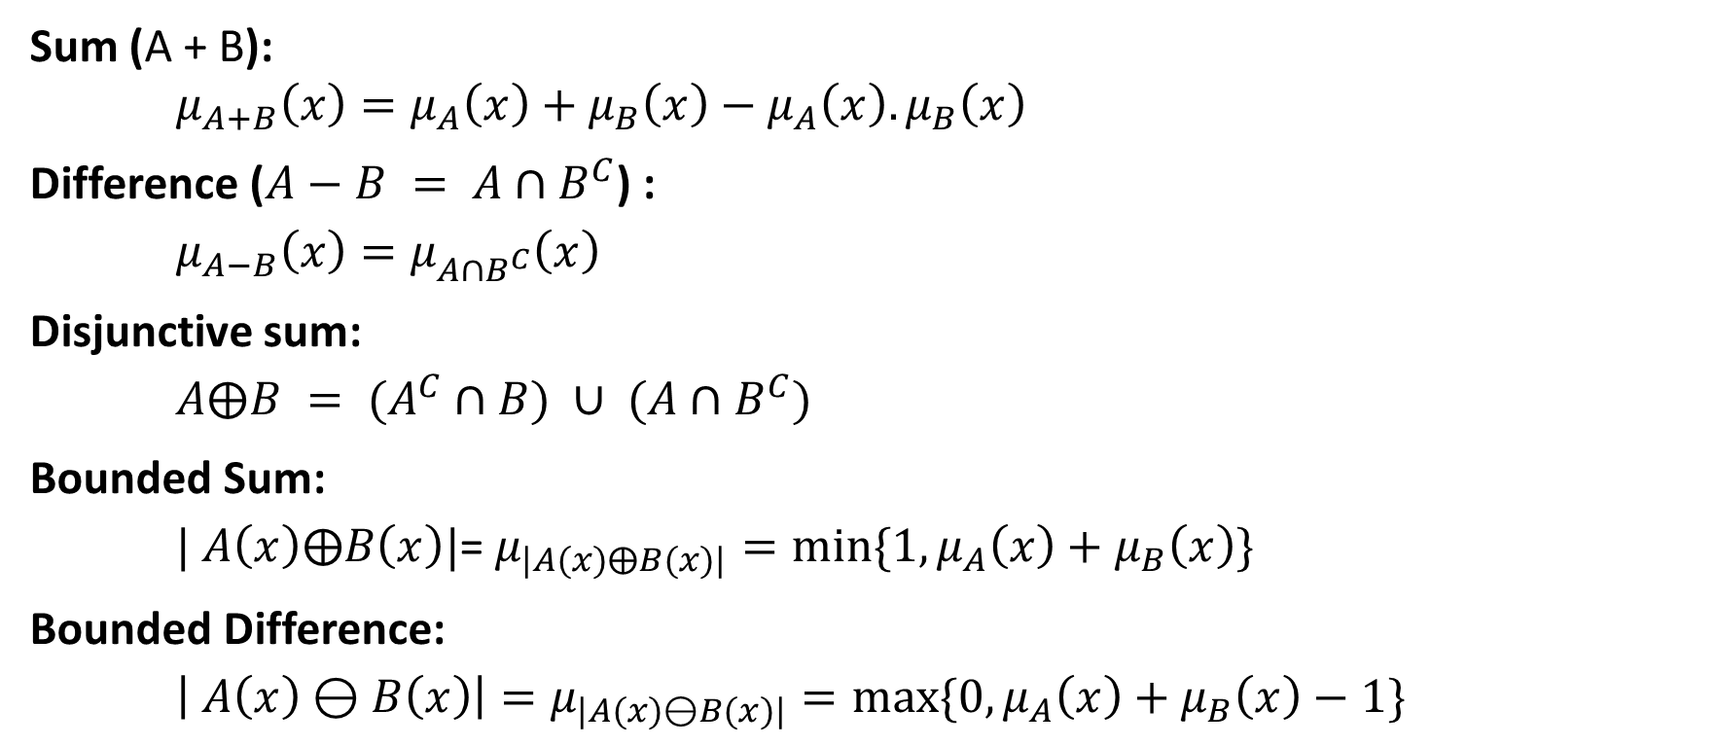
Basic fuzzy set operations: Sum and Difference
Sum (A + B):
$μ_{A+B}\left(x\right)=μ_{A}\left(x\right)+μ_{B}\left(x\right)−μ_{A}\left(x\right).μ_{B}\left(x\right)$
Difference ($A−B = A∩B^{C}$) :
$μ_{A−B}\left(x\right)=μ_{A∩B^{C}}\left(x\right)$
Disjunctive sum:
$A⨁B = (A^{C}∩B) ∪ (A∩B^{C})$
Bounded Sum:
$| A\left(x\right)⨁B\left(x\right)|$= $μ_{|A(x)⨁B(x)|}=min⁡\{1,μ_{A}\left(x\right)+μ_{B}\left(x\right)\}$
Bounded Difference:
$\left| A\left(x\right)⊖B\left(x\right)\right|=μ_{|A(x)⊖B(x)|}=max⁡\{0,μ_{A}\left(x\right)+μ_{B}\left(x\right)−1\}$

Slide 54
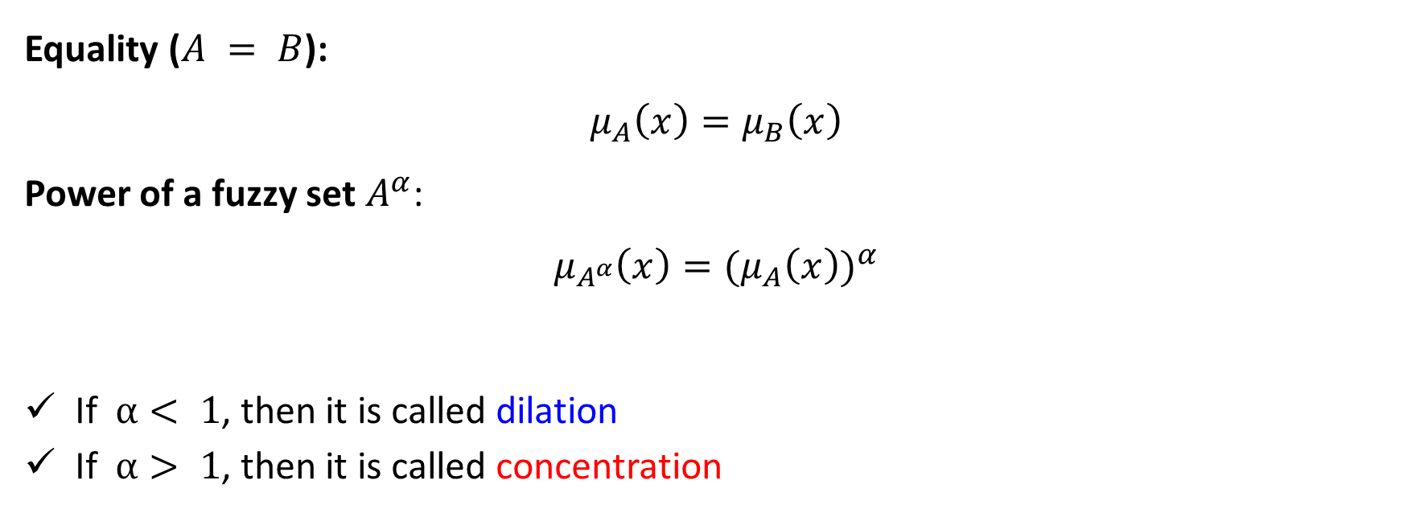
Basic fuzzy set operations: Equality and Power
Equality ($A = B$):
$$μ_{A}\left(x\right)=μ_{B}\left(x\right)$$
Power of a fuzzy set $A^{α}$:
$$μ_{A^{α}}\left(x\right)={{(μ}_{A}\left(x\right))}^{α}$$
If $α< 1$, then it is called dilation
If $α> 1$, then it is called concentration

Slide 55
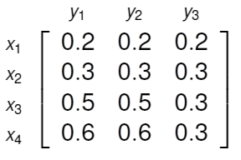
Basic fuzzy set operations: Cartesian product
Caretsian Product ($A×B$): $μ_{A×B}\left(x,y\right)=min⁡(μ_{A}\left(x\right),μ_{B}\left(y\right))$
Example:
$A\left(x\right)=\{(x_{1}, 0.2), (x_{2}, 0.3), (x_{3}, 0.5), (x_{4}, 0.6)\}$
$B\left(y\right)=\{\left(y_{1}, 0.8\right), \left(y_{2}, 0.6\right), \left(y_{3}, 0.3\right)\}$
$A×B=\min\left(μ_{A}\left(x\right),μ_{B}\left(y\right)\right)=$

Slide 56
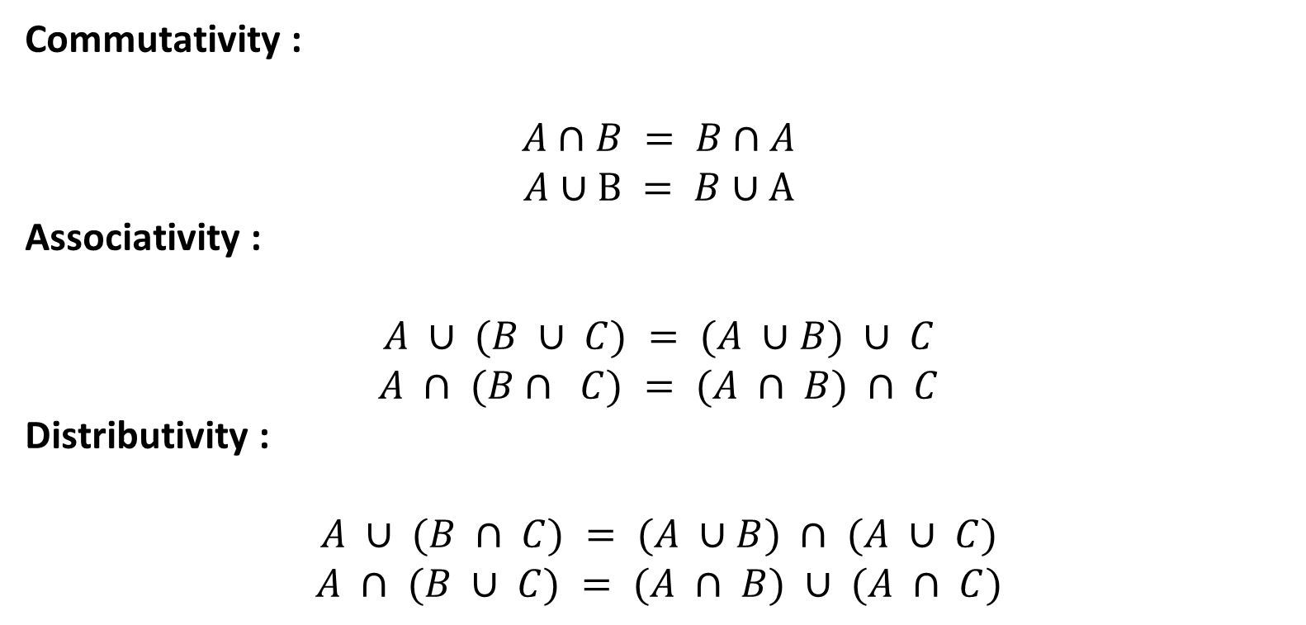
Properties of fuzzy sets
Commutativity :
$$A∩B = B∩A$$
$$A∪B = B∪A$$
Associativity :
$$A ∪ (B ∪ C) = (A ∪B) ∪ C$$
$$A ∩ (B∩ C) = (A ∩ B) ∩ C$$
Distributivity :
$$A ∪ (B ∩ C) = (A ∪B) ∩ (A ∪ C)$$
$$A ∩ (B ∪ C) = (A ∩ B) ∪ (A ∩ C)$$

Slide 57
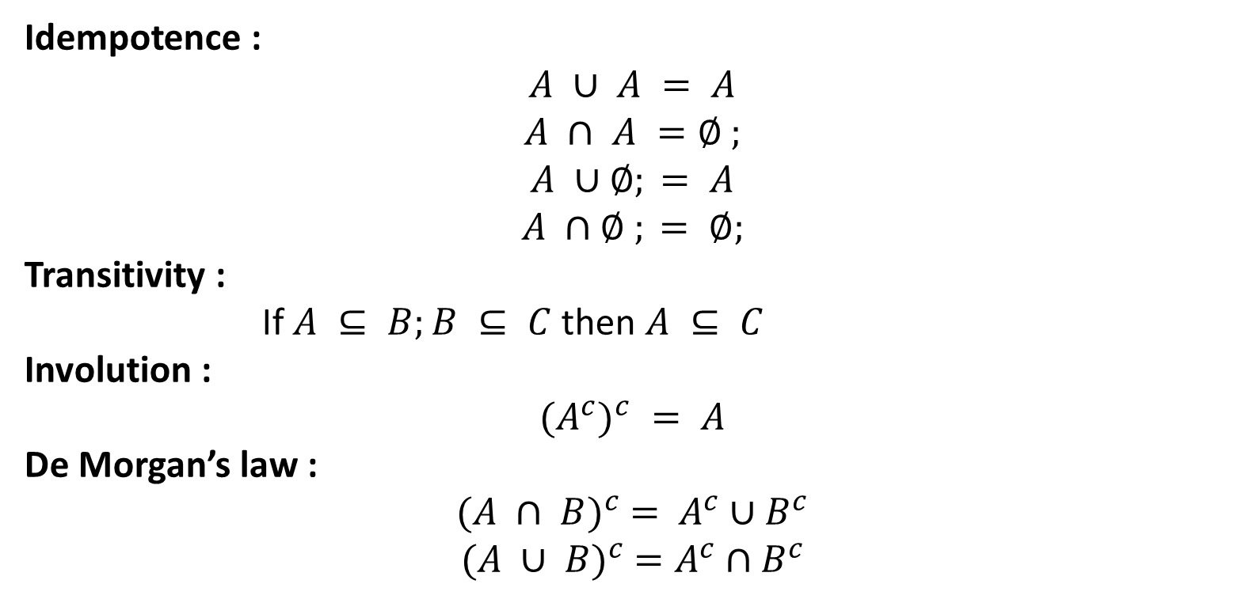
Properties of fuzzy sets
Idempotence :
$$A ∪ A = A$$
$$A ∩ A =∅ ;$$
$$A ∪∅; = A$$
$$A ∩∅ ; = ∅;$$
Transitivity :
If $A ⊆ B;B ⊆ C$then $A ⊆ C$
Involution :
$${{(A}^{c})}^{c} = A$$
De Morgan’s law :
$${(A ∩ B)}^{c} = A^{c}∪B^{c}$$
$${(A ∪ B)}^{c} =A^{c}∩B^{c}$$

Slide 58
RELATIONS
Relations represent mappings between sets and connectives in logic.
A classical binary relation represents the presence or absence of a connection or interaction or association between the elements of two sets.
Fuzzy binary relations are a generalization of crisp binary relations, and they allow various degrees of relationship (association) between elements.

Slide 59
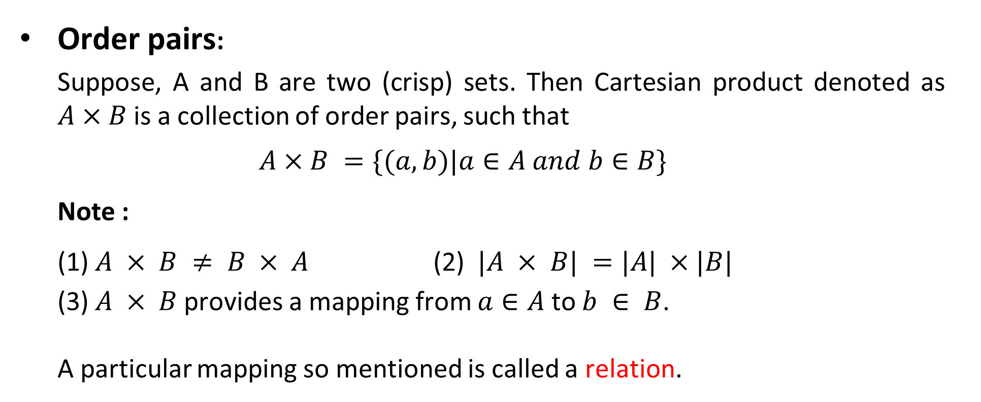
Crisp relations
Order pairs:
Suppose, A and B are two (crisp) sets. Then Cartesian product denoted as $A×B$is a collection of order pairs, such that
$$A×B =\{(a, b)|a∈A and b∈B\}$$
Note :
(1) $A × B ≠ B × A$(2) $|A × B| =|A| ×|B|$
(3) $A × B$provides a mapping from $a∈A$to $b ∈ B$.
A particular mapping so mentioned is called a relation.

Slide 60
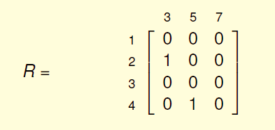
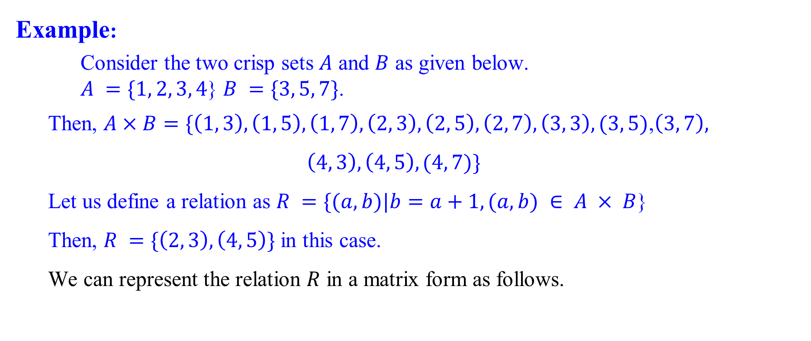
Crisp relations
Example:
Consider the two crisp sets $A$ and $B$ as given below.
$A =\{1, 2, 3, 4$} $B =\{3, 5, 7\}$.
Then, $A×B=\{\left(1, 3\right), \left(1, 5\right), \left(1, 7\right), \left(2, 3\right), \left(2, 5\right), \left(2, 7\right), \left(3, 3\right), (3, 5)$,$\left(3, 7\right),$
$$\left(4, 3\right), \left(4, 5\right), (4, 7)\}$$
Let us define a relation as $R =\{(a, b)|b=a+1,(a, b) ∈ A × B$}
Then, $R =\{\left(2, 3\right), \left(4, 5\right)\}$ in this case.
We can represent the relation $R$ in a matrix form as follows.

Slide 61
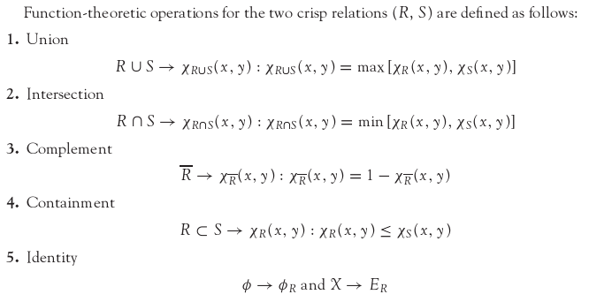
OPERATIONS ON CRISP RELATIONS

Slide 62
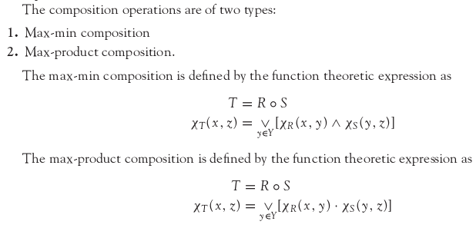
COMPOSITION ON CRISP RELATIONS

Slide 63

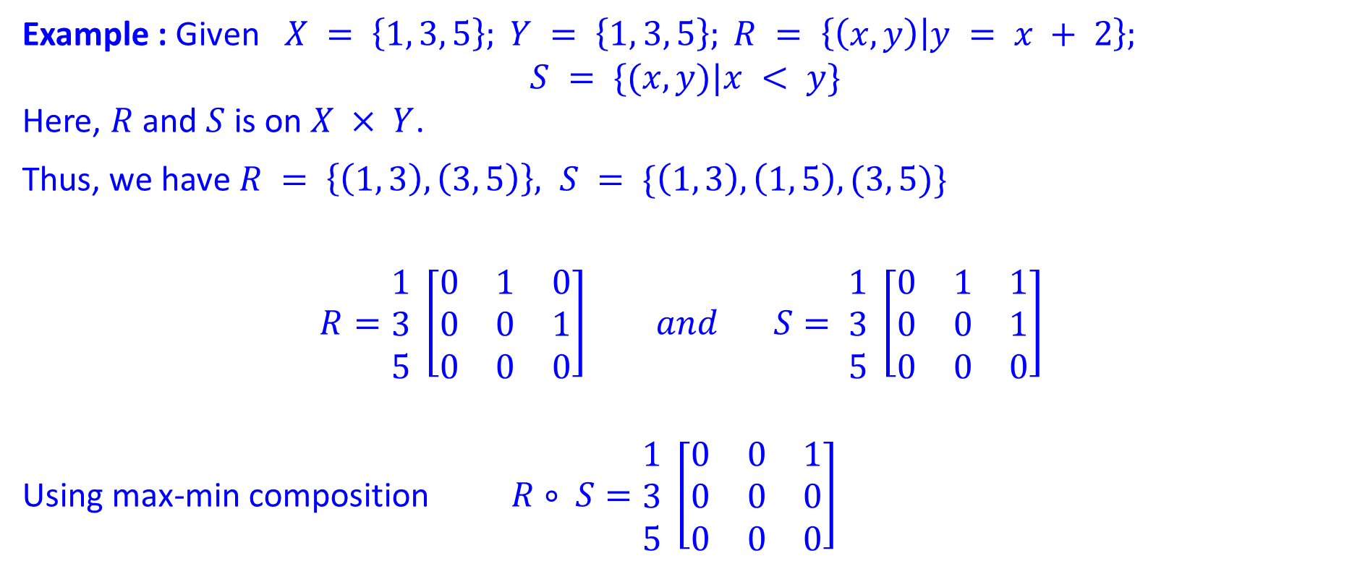
Composition: Example
Example : Given $X = \left\{1, 3, 5\right\}; Y = \left\{1, 3, 5\right\}; R = \left\{\left(x, y\right) | y = x + 2\right\};$
$$S = \{(x, y)|x < y\}$$
Here, $R$ and $S$ is on $X × Y$.
Thus, we have $R = \left\{\left(1, 3\right), \left(3, 5\right)\right\}, S = \{\left(1, 3\right), \left(1, 5\right), (3, 5)\}$
$$R=\begin{matrix}1 \\ 3 \\ 5\end{matrix} \left[\begin{matrix}0 & 1 & 0 \\ 0 & 0 & 1 \\ 0 & 0 & 0\end{matrix}\right] and S= \begin{matrix}1 \\ 3 \\ 5\end{matrix} \left[\begin{matrix}0 & 1 & 1 \\ 0 & 0 & 1 \\ 0 & 0 & 0\end{matrix}\right]$$
Using max-min composition $R∘ S=\begin{matrix}1 \\ 3 \\ 5\end{matrix} \left[\begin{matrix}0 & 0 & 1 \\ 0 & 0 & 0 \\ 0 & 0 & 0\end{matrix}\right]$

Slide 66
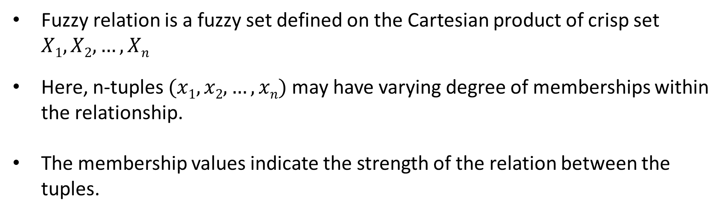
Fuzzy relations
Fuzzy relation is a fuzzy set defined on the Cartesian product of crisp set $X1,X2, …,Xn$
Here, n-tuples $(x1, x2, …, xn)$may have varying degree of memberships within the relationship.
The membership values indicate the strength of the relation between the tuples.

Slide 67
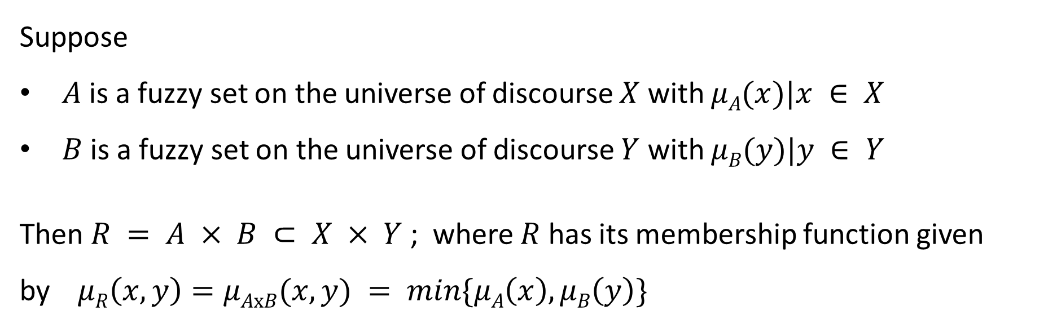
Fuzzy Cartesian product
Suppose
$A$ is a fuzzy set on the universe of discourse $X$ with $μA(x)|x ∈ X$
$B$ is a fuzzy set on the universe of discourse $Y$ with $μB(y)|y ∈ Y$
Then $R = A × B ⊂ X × Y$; where $R$ has its membership function given by$μR\left(x, y\right)=μAxB(x, y) = min⁡\{μA\left(x\right),μB\left(y\right)\}$

Slide 68
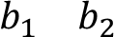
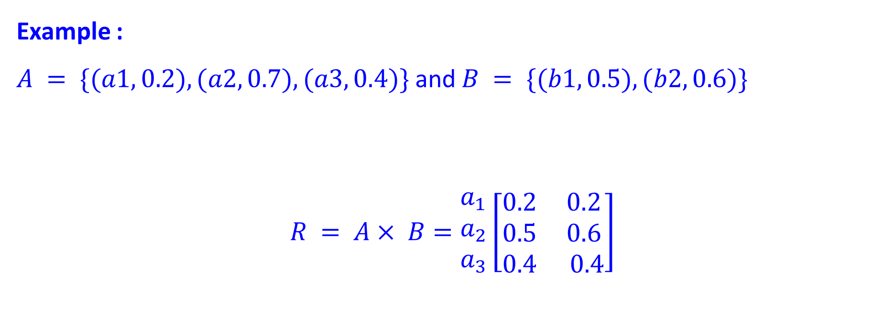
Fuzzy Cartesian product
Example :
$A = \{(a1, 0.2), (a2, 0.7), (a3, 0.4)\}$and $B = \{(b1, 0.5), (b2, 0.6)\}$
$$R = A× B=\begin{matrix}a_{1} \\ a_{2} \\ a_{3}\end{matrix}\left[\begin{matrix}0.2 & 0.2 \\ 0.5 & 0.6 \\ 0.4 & 0.4\end{matrix}\right]$$

Slide 69

Operations on Fuzzy relations
Let $R$ and $S$ be two fuzzy relations on $A×B$.
Union: $μRUS(a, b) = max⁡\{μR\left(a, b\right),μS(a, b)\}$
Intersection: $μ_{R∩S}(a, b) = min⁡\{μR\left(a, b\right),μS(a, b)\}$
Complement: $μ_{\overline{R}} \left(a, b\right)= 1−μR(a, b)$
Composition: $T = R∘S$
$$μ_{R∘S} = \max_{y∈Y} \{min\left(μR\left(x, y\right),μS\left(y, z\right)\right)\}$$

Slide 70


Operations on Fuzzy relations: Example
Example : $X =(x_{1},x_{2},x_{3}), Y = \left(y_{1},y_{2}\right), Z = \left(z_{1},z_{2},z_{3}\right),$
$$R=\begin{matrix}x_{1} \\ x_{2} \\ x_{3}\end{matrix}\left[\begin{matrix}0.5 & 0.1 \\ 0.2 & 0.9 \\ 0.8 & 0.6\end{matrix}\right] and S= \begin{matrix}y_{1} \\ y_{2}\end{matrix}\left[\begin{matrix}0.6 & 0.4 & 0.7 \\ 0.5 & 0.8 & 0.9\end{matrix}\right]$$
$$R∘S=\begin{matrix}x_{1} \\ x_{2} \\ x_{3}\end{matrix}\left[\begin{matrix}0.5 & 0.4 & 0.5 \\ 0.5 & 0.8 & 0.9 \\ 0.6 & 0.6 & 0.7\end{matrix}\right]$$
$$μ_{R∘S} \left(x1, y1\right)=\max\left\{\min\left(μ_{R}\left(x1, y1\right),μ_{S}\left(y1, z1\right)),\min{(μ_{R}\left(x1, y2\right)},μ_{S}\left(y2, z1\right)\right)\right\}=\max\left\{min\left(0.5, 0.6\right),\min\left(0.1, 0.5\right)\right\}=\max\left\{0.5, 0.1\right\}= 0.5 and so on.$$

Slide 71


Fuzzy relation : An example
Consider the following two sets $P$ and $D,$ which represent a set of paddy plants and a set of plant diseases. More precisely
$P = \{P_{1},P_{2},P_{3},P_{4}\}$a set of four varieties of paddy plants
$D = \{D_{1},D_{2},D_{3},D_{4}\}$of the four various diseases affecting the plants.
In addition to these, also consider another set $S = \{S_{1},S_{2},S_{3},S_{4}\}$be the common symptoms of the diseases.
Let, $R$ be a relation on $P×D$, representing which plant is susceptible to which diseases, which is stated as
$$R=\begin{matrix}P_{1} \\ P_{2} \\ \begin{aligned}P_{3} \\ P_{4}\end{aligned}\end{matrix}\left[\begin{matrix}0.6 & 0.6 & 0.9 & 0.8 \\ 0.1 & 0.2 & 0.9 & 0.8 \\ 0.9 & 0.3 & 0.4 & 0.8 \\ 0.9 & 0.8 & 0.4 & 0.2\end{matrix}\right]$$

Slide 72


Fuzzy relation : An example
Also, consider $T$ be the another relation on $D×S$, which is given by
$$R=\begin{matrix}P_{1} \\ P_{2} \\ \begin{aligned}P_{3} \\ P_{4}\end{aligned}\end{matrix}\left[\begin{matrix}0.6 & 0.6 & 0.9 & 0.8 \\ 0.1 & 0.2 & 0.9 & 0.8 \\ 0.9 & 0.3 & 0.4 & 0.8 \\ 0.9 & 0.8 & 0.4 & 0.2\end{matrix}\right] S=\begin{matrix}D_{1} \\ D_{2} \\ \begin{aligned}D_{3} \\ D_{4}\end{aligned}\end{matrix}\left[\begin{matrix}0.1 & 0.2 & 0.7 & 0.9 \\ 1.0 & 1.0 & 0.4 & 0.6 \\ 0.0 & 0.0 & 0.5 & 0.9 \\ 0.9 & 1.0 & 0.8 & 0.2\end{matrix}\right]$$
Obtain the association of plants with the different symptoms of the disease using
max-min composition.
Hint: Find $R∘T$, and verify that
$$R∘S=\begin{matrix}P_{1} \\ P_{2} \\ \begin{aligned}P_{3} \\ P_{4}\end{aligned}\end{matrix}\left[\begin{matrix}0.8 & 0.8 & 0.8 & 0.9 \\ 0.8 & 0.8 & 0.8 & 0.9 \\ 0.8 & 0.8 & 0.8 & 0.9 \\ 0.8 & 0.8 & 0.7 & 0.9\end{matrix}\right]$$

Slide 73



Fuzzy relation : Another example
Let, $R = x$is relevant to $y$
and $S = y$is relevant to $z$
be two fuzzy relations defined on $X×Y$ and $Y×Z$, respectively, where $X = \{1,2,3\}$, $Y = \{α,β,γ,δ\}$ and $Z = \{a,b\}.$ Assume that $R$ and $S$ can be expressed with the following relation matrices :
$$R=\begin{matrix}1 \\ 2 \\ 3\end{matrix}\left[\begin{matrix}0.1 & 0.3 & 0.5 & 0.7 \\ 0.4 & 0.2 & 0.8 & 0.9 \\ 0.6 & 0.8 & 0.3 & 0.2\end{matrix}\right] and S= \begin{matrix}α \\ β \\ \begin{aligned}γ \\ δ\end{aligned}\end{matrix}\left[\begin{matrix}0.9 & 0.1 \\ 0.2 & 0.3 \\ 0.5 & 0.6 \\ 0.7 & 0.2\end{matrix}\right]$$

Slide 74

Fuzzy relation : Another example
Now, we want to find $R∘S$, which can be interpreted as a derived fuzzy relation $x$ is relevant to $z$.
Suppose, we are only interested in the degree of relevance between $2 ∈ X$and $a ∈ Z$. Then, using max-min composition,
$$μ_{R∘S} (2, a) = max⁡\{\left(0.4∧0.9\right), \left(0.2∧0.2\right), \left(0.8∧0.5\right), \left(0.9∧0.7\right)\}$$
$$= max⁡\{0.4, 0.2, 0.5, 0.7\} = 0.7$$

Slide 75
Fuzzy Propositions
Two-valued logic vs. Multi-valued logic
Examples of Fuzzy proposition
Fuzzy proposition vs. Crisp proposition

Slide 76
Two-valued logic vs. Multi-valued logic
The basic assumption upon which crisp logic is based – that every proposition is either TRUE or FALSE.
The classical two-valued logic can be extended to multi-valued logic.
As an example, three valued logic to denote true(1), false(0) and indeterminacy ( 1/2 ).

Slide 77
Fuzzy Proposition: Example 1
P: Ram is honest
T(P) = 0.0 : Absolutely false
T(P) = 0.2 : Partially false
T(P) = 0.4 : May be false or not false
T(P) = 0.6 : May be true or not true
T(P) = 0.8 : Partially true
T(P) = 1.0 : Absolutely true

Slide 78

Fuzzy Proposition: Example 2
P: Marry is efficient; T(P)=0.8
Q: Ram is efficient; T(Q)=0.6
Marry is not efficient.
$T\left(¬P\right)=1−T\left(P\right)=0.2$
Marry is efficient and so is Ram
$T\left(P∩Q\right)=\min\left\{T\left(p\right), T\left(Q\right)\right\}=0.6$
Either Marry or Ram is efficient
$T\left(P∪Q\right)=\max\left\{T\left(P\right), T\left(Q\right)\right\}=0.8$
If Marry is efficient then so is Ram
$T\left(P→Q\right)=\max\left\{1−T\left(P\right), T\left(Q\right)\right\}=0.6$

Slide 79
Fuzzy proposition vs. Crisp proposition
The fundamental difference between crisp (classical) proposition and fuzzy propositions is in the range of their truth values.
While each classical proposition is required to be either true or false, the truth or falsity of fuzzy proposition is a matter of degree.
The degree of truth of each fuzzy proposition is expressed by a value in the interval [0,1] both inclusive.

Slide 80

Fuzzy Rule
A fuzzy implication (also known as fuzzy If-then rule, fuzzy rule, of fuzzy conditional statement) assumes the form:
$$If x is A then y is B$$
Where, A & B are two linguistic variables defined by fuzzy sets A and B on the universe of discourses X and Y, respectively.
Often, x is A called the antecedent or premise, while y is B is called the consequence or conclusion.

Slide 81

Examples of fuzzy implications
If pressure is High then temperature is Low
If mango is Yellow then mango is Sweet else mango is sour
If road is Good then driving is Smooth else traffic is High
The fuzzy implication is denoted as $R:A→B$
In essence, it represents a binary fuzzy relation R on the (Cartesian) product A X B.

Slide 82

Fuzzy implications: Example 2

Slide 83

Fuzzy implications: Example 2

Slide 84

Fuzzy Inference
Let’s start with propositional logic. We know the following in propositional logic
Modus Ponens. $P, P→Q, ↔Q$
Modus Tollens. $P→Q, ¬Q, ↔$ $¬P$
Chain Rule. $P→Q, Q→R, ↔P→R$

Slide 85

Inferring procedures in Fuzzy Logic

Slide 86

Inferring procedures in Fuzzy Logic

Slide 87


Generalized Modus Ponens: Example

Slide 88

Generalized Modus Ponens: Example

Slide 89

Generalized Modus Ponens: Example

Slide 90

Generalized Modus Ponens: Example

Slide 91


Generalized Modus Tollens: Example

Slide 92

Generalized Modus Tollens: Example

Slide 93


Defuzzyfication Techniques
What is Defuzzyfication?
Why Defuzzyfication?

Slide 94
Defuzzyfication Techniques
A number of Defuzzyfication methods are known. Such as
Lambda-cut method
Weighted average method
Maxima methods
Centroid methods

Slide 95

Lambda-cut method
Lambda-cut method is applicable to derive crisp value of a fuzzy set or relation.
Lambda-cut method for fuzzy relation
The same has been applied to fuzzy set
Lambda-cut method for fuzzy set
In many literature, Lambda-cut method is also alternatively termed as Alpha-cut method
In this method a fuzzy set A is transformed into a crisp set $A_{λ}$ for a given value of $λ(0≤$ $λ≤1)$
In other word, $A_{λ}=\{x|μ_{A}(x$) $≥λ\}$
That is, the value of lambda-cut set $A_{λ}$ is x, when the membership value corresponding to x is greater than or equal to the specified $λ$.

Slide 96

Lambda-cut for a fuzzy set: example

Slide 97

Lambda-cut for a fuzzy relation: example

Slide 98

Some Properties of Lambda-cut set

Slide 99

Some Properties of Lambda-cut relations

Slide 101
Defuzzyfication Techniques
Following Defuzzyfication methods are known to calculate crisp output.
Maxima methods
Height Method
First of Maxima
Last of Maxima
Mean of Maxima
Centroid methods
Centre of Gravity
Center of sum method
Center of Area Method
Weighted average method

Slide 102

Maxima methods: Height Method

Slide 105

Maxima methods: First of Maxima

Slide 106

Maxima methods: Last of Maxima

Slide 107


Maxima methods: Mean of Maxima

Slide 109


Centroid methods: Center of Gravity

Slide 110

Centroid methods: Center of Gravity

Slide 111


Slide 113


Centroid methods: Center of Sum

Slide 114


Centroid methods: Center of Sum

Slide 115

Centroid methods: Center of Largest Area

Slide 116


Weighted Average Method

